Slide 1
Chapter 8: Main Memory

Slide 2
Objectives
To provide a detailed description of various ways of organizing memory hardware
To discuss various memory-management techniques, including paging and segmentation

Slide 3
Address Binding
Programs on disk, ready to be brought into memory to execute form an input queue
  Without support, must be loaded into address 0000
Further, addresses represented in different ways at different stages of a program’s life
  Source code addresses usually symbolic
  Compiled code addresses bind to relocatable addresses
    i.e., “14 bytes from beginning of this module”
  Linker or loader will bind relocatable addresses to absolute addresses
    i.e., 74014
  Each binding maps one address space to another

Slide 4
Binding of Instructions and Data to Memory
Address binding of instructions and data to memory addresses can happen at three different stages
  Compile time: If memory location known a priori, absolute code can be generated; must recompile code if starting location changes
  Load time: Must generate relocatable code if memory location is not known at compile time
  Execution time: Binding delayed until run time if the process can be moved during its execution from one memory segment to another
    Need hardware support for address maps (e.g., base and limit registers)

Slide 5

Multistep Processing of a User Program

Slide 6
Logical vs. Physical Address Space
The concept of a logical address space that is bound to a separate physical address space is central to proper memory management
  Logical address – generated by the CPU; also referred to as virtual address
  Physical address – address seen by the memory unit
Logical and physical addresses are the same in compile-time and load-time address-binding schemes; logical (virtual) and physical addresses differ in execution-time address-binding scheme
Logical address space is the set of all logical addresses generated by a program
Physical address space is the set of all physical addresses generated by a program

Slide 7
Memory-Management Unit (MMU)
Hardware device that at run time maps virtual to physical address
To start, consider simple scheme where the value in the relocation register is added to every address generated by a user process at the time it is sent to memory
  Base register now called relocation register
  MS-DOS on Intel 80x86 used 4 relocation registers
The user program deals with logical addresses; it never sees the real physical addresses
  Execution-time binding occurs when reference is made to location in memory
  Logical address bound to physical addresses

Slide 8

Dynamic relocation using a relocation register
Routine is not loaded until it is called
Better memory-space utilization; unused routine is never loaded
All routines kept on disk in relocatable load format
Useful when large amounts of code are needed to handle infrequently occurring cases
No special support from the operating system is require

Slide 9
Swapping
A process can be swapped temporarily out of memory to a backing store, and then brought back into memory for continued execution
  Total physical memory space of processes can exceed physical memory
Backing store – fast disk large enough to accommodate copies of all memory images for all users; must provide direct access to these memory images
Roll out, roll in – swapping variant used for priority-based scheduling algorithms; lower-priority process is sapped out so higher-priority process can be loaded and executed
Major part of swap time is transfer time; total transfer time is directly proportional to the amount of memory swapped
System maintains a ready queue of ready-to-run processes which have memory images on disk

Slide 10
Swapping (Cont.)
Does the swapped out process need to swap back in to same physical addresses?
Depends on address binding method
  Plus consider pending I/O to / from process memory space
Modified versions of swapping are found on many systems (i.e., UNIX, Linux, and Windows)
  Swapping normally disabled
  Started if more than threshold amount of memory allocated
  Disabled again once memory demand reduced below threshold

Slide 11

Schematic View of Swapping

Slide 12
Context Switch Time including Swapping
If next processes to be put on CPU is not in memory, need to swap out a process and swap in target process
Context switch time can then be very high
100MB process swapping to hard disk with transfer rate of 50MB/sec
  Swap out time of 2000 ms
  Plus swap in of same sized process
  Total context switch swapping component time of 4000ms (4 seconds)
Can reduce if reduce size of memory swapped – by knowing how much memory really being used
  System calls to inform OS of memory use via request_memory() and release_memory()

Slide 13
Context Switch Time and Swapping (Cont.)
Other constraints as well on swapping
  Pending I/O – can’t swap out as I/O would occur to wrong process
  Or always transfer I/O to kernel space, then to I/O device
    Known as double buffering, adds overhead
Standard swapping not used in modern operating systems
  But modified version common
    Swap only when free memory extremely low

Slide 14
Contiguous Allocation
Main memory must support both OS and user processes
Limited resource, must allocate efficiently
Contiguous allocation is one early method
Main memory usually into two partitions:
  Resident operating system, usually held in low memory with interrupt vector
  User processes then held in high memory
  Each process contained in single contiguous section of memory

Slide 15
Contiguous Allocation (Cont.)
Relocation registers used to protect user processes from each other, and from changing operating-system code and data
  Base register contains value of smallest physical address
  Limit register contains range of logical addresses – each logical address must be less than the limit register
  MMU maps logical address dynamically
  Can then allow actions such as kernel code being transient and kernel changing size

Slide 16

Hardware Support for Relocation and Limit Registers

Slide 17

Multiple-partition allocation
Multiple-partition allocation
  Degree of multiprogramming limited by number of partitions
  Variable-partition sizes for efficiency (sized to a given process’ needs)
  Hole – block of available memory; holes of various size are scattered throughout memory
  When a process arrives, it is allocated memory from a hole large enough to accommodate it
  Process exiting frees its partition, adjacent free partitions combined
  Operating system maintains information about:
  a) allocated partitions b) free partitions (hole)

Slide 18
Dynamic Storage-Allocation Problem
How to satisfy a request of size n from a list of free holes?
First-fit: Allocate the first hole that is big enough
Best-fit: Allocate the smallest hole that is big enough; must search entire list, unless ordered by size
  Produces the smallest leftover hole
Worst-fit: Allocate the largest hole; must also search entire list
  Produces the largest leftover hole
First-fit and best-fit are better than worst-fit in terms of speed and storage utilization

Slide 19
Fragmentation
External Fragmentation – total memory space exists to satisfy a request, but it is not contiguous
Internal Fragmentation – allocated memory may be slightly larger than requested memory; this size difference is memory internal to a partition, but not being used
First fit analysis reveals that given N blocks allocated, 0.5 N blocks lost to fragmentation
  1/3 may be unusable -> 50-percent rule

Slide 20
Segmentation
Memory-management scheme that supports user view of memory
A program is a collection of segments
  A segment is a logical unit such as:
main program
procedure
function
method
object
local variables, global variables
common block
stack
symbol table
arrays

Slide 21

User’s View of a Program

Slide 22
Logical View of Segmentation
1
1
4
2
3
4
2
3
user space
physical memory space

Slide 23

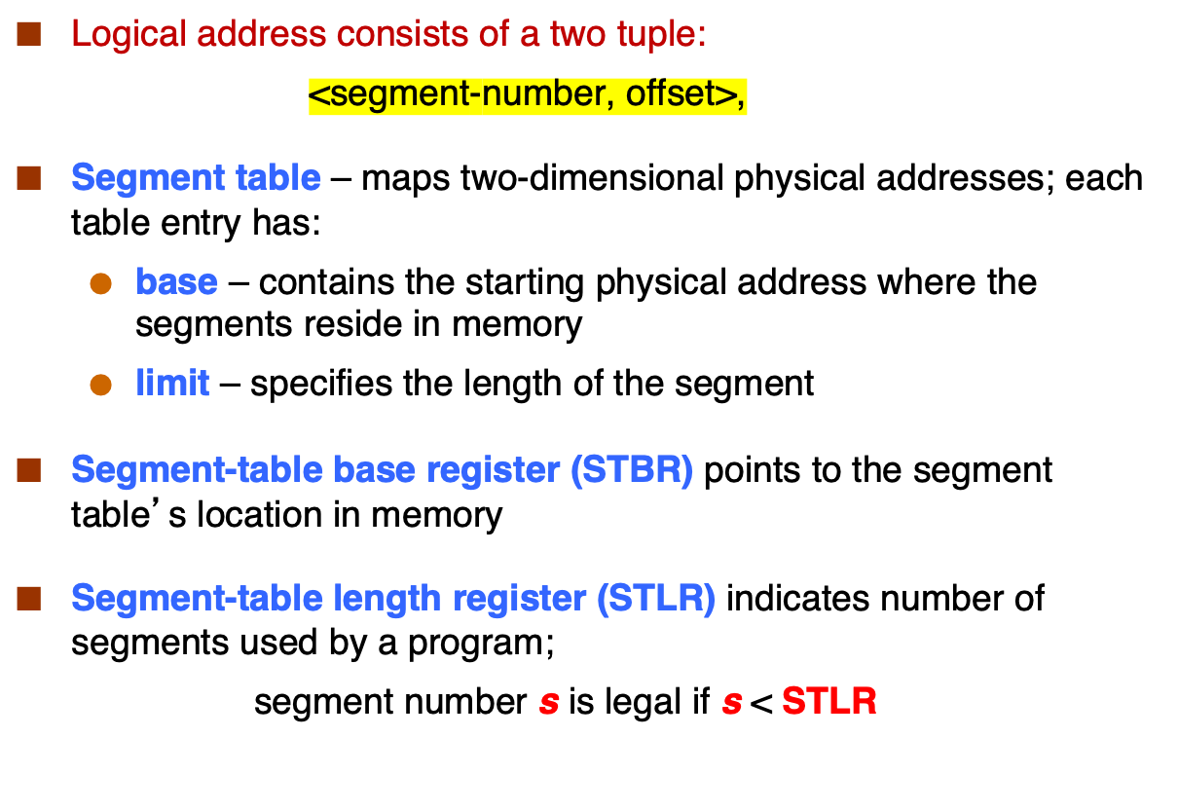

Slide 24
Segmentation Architecture (Cont.)
Protection
  With each entry in segment table associate:
    validation bit = 0 ⇒ illegal segment
    read/write/execute privileges
Protection bits associated with segments; code sharing occurs at segment level
Since segments vary in length, memory allocation is a dynamic storage-allocation problem
A segmentation example is shown in the following diagram

Slide 25

Segmentation Hardware

Slide 26
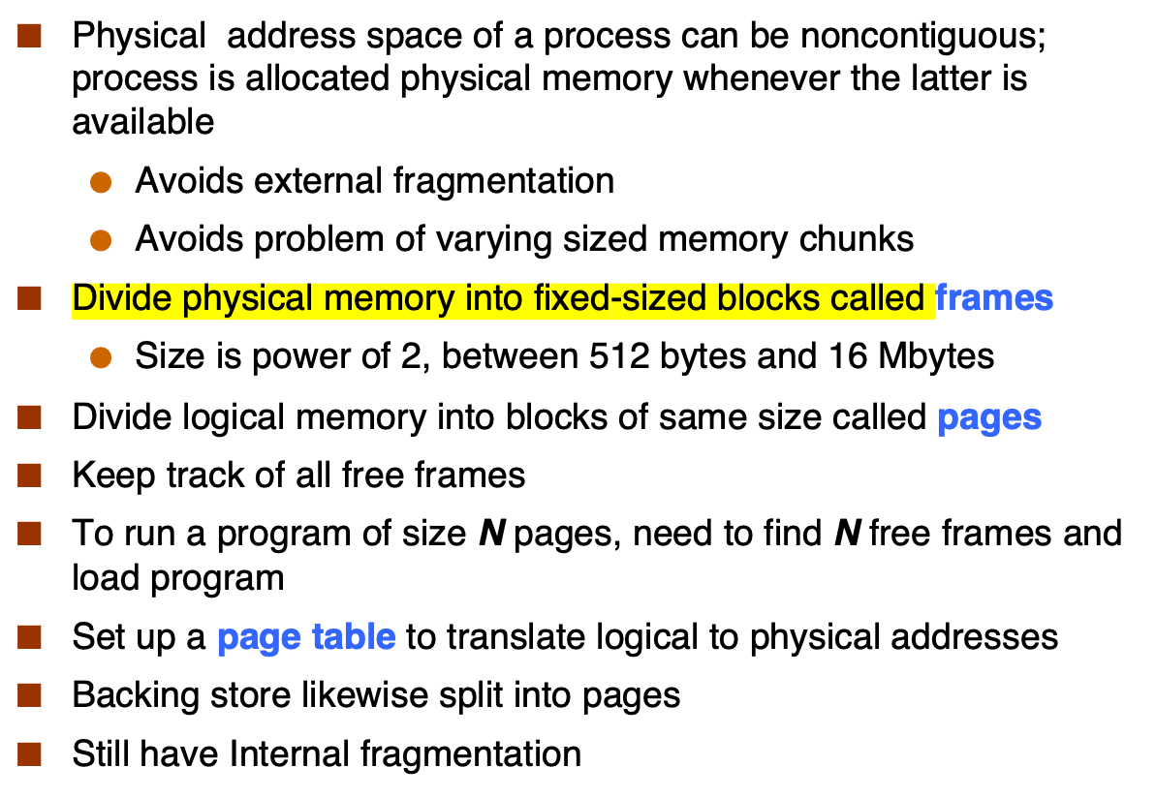
Paging

Slide 27

Address Translation Scheme
Address generated by CPU is divided into:
  Page number (p) – used as an index into a page table which contains base address of each page in physical memory
  Page offset (d) – combined with base address to define the physical memory address that is sent to the memory unit
  For given logical address space 2^{m} and page size 2^{n}

Slide 28

Paging Hardware

Slide 29

Paging Model of Logical and Physical Memory

Slide 30

Paging Example
Logical address space = 2^{m}
Page size = 2^{n}
n=2 and m=4 32-byte memory and 4-byte pages

Slide 31
Paging (Cont.)
Calculating internal fragmentation
  Page size = 2,048 bytes
  Process size = 72,766 bytes
  35 pages + 1,086 bytes
  Internal fragmentation of 2,048 - 1,086 = 962 bytes
  Worst case fragmentation = 1 frame – 1 byte
  On average fragmentation = 1 / 2 frame size
  So small frame sizes desirable?
  But each page table entry takes memory to track
  Page sizes growing over time
    Solaris supports two page sizes – 8 KB and 4 MB
Process view and physical memory now very different
By implementation process can only access its own memory

Slide 32

Free Frames
Before allocation
After allocation

Slide 33
Implementation of Page Table
Page table is kept in main memory
Page-table base register (PTBR) points to the page table
Page-table length register (PTLR) indicates size of the page table
In this scheme every data/instruction access requires two memory accesses
  One for the page table and one for the data / instruction
The two memory access problem can be solved by the use of a special fast-lookup hardware cache called associative memory or translation look-aside buffers (TLBs)

Slide 34
Implementation of Page Table (Cont.)
Some TLBs store address-space identifiers (ASIDs) in each TLB entry – uniquely identifies each process to provide address-space protection for that process
  Otherwise need to flush at every context switch
TLBs typically small (64 to 1,024 entries)
On a TLB miss, value is loaded into the TLB for faster access next time
  Replacement policies must be considered
  Some entries can be wired down for permanent fast access

Slide 35
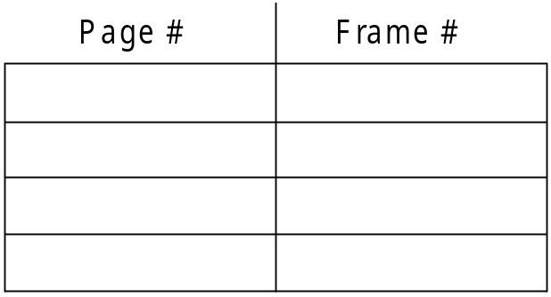
Associative Memory
Associative memory – parallel search
Address translation (p, d)
  If p is in associative register, get frame # out
  Otherwise get frame # from page table in memory

Slide 36

Paging Hardware With TLB

Slide 37
Effective Access Time
Associative Lookup = ε time unit
  Can be < 10% of memory access time
Hit ratio = α
  Hit ratio – percentage of times that a page number is found in the associative registers; ratio related to number of associative registers
Consider α = 80%, ε = 20ns for TLB search, 100ns for memory access
Effective Access Time (EAT)
EAT = (1 + ε) α + (2 + ε)(1 – α)
= 2 + ε – α
Consider α = 80%, ε = 20ns for TLB search, 100ns for memory access
  EAT = 0.80 x 100 + 0.20 x 200 = 120ns
Consider more realistic hit ratio -> α = 99%, ε = 20ns for TLB search, 100ns for memory access
  EAT = 0.99 x 100 + 0.01 x 200 = 101ns

Slide 38
Memory Protection
Memory protection implemented by associating protection bit with each frame to indicate if read-only or read-write access is allowed
  Can also add more bits to indicate page execute-only, and so on
Valid-invalid bit attached to each entry in the page table:
  “valid” indicates that the associated page is in the process’ logical address space, and is thus a legal page
  “invalid” indicates that the page is not in the process’ logical address space
  Or use page-table length register (PTLR)
Any violations result in a trap to the kernel

Slide 39

Valid (v) or Invalid (i) Bit In A Page Table

Slide 40
End of Chapter 8

